Slide 1

ICE 3161
COMMUNICATION ENGINEERING
Dr. Asif Zaman
Professor, CSE, RU

Slide 2
Transmission of Digital Signals
The fundamental question is, How can we send a digital signal from point A to point B?
…a digital signal by using one of two different approaches:
baseband transmission or
broadband transmission

Slide 3
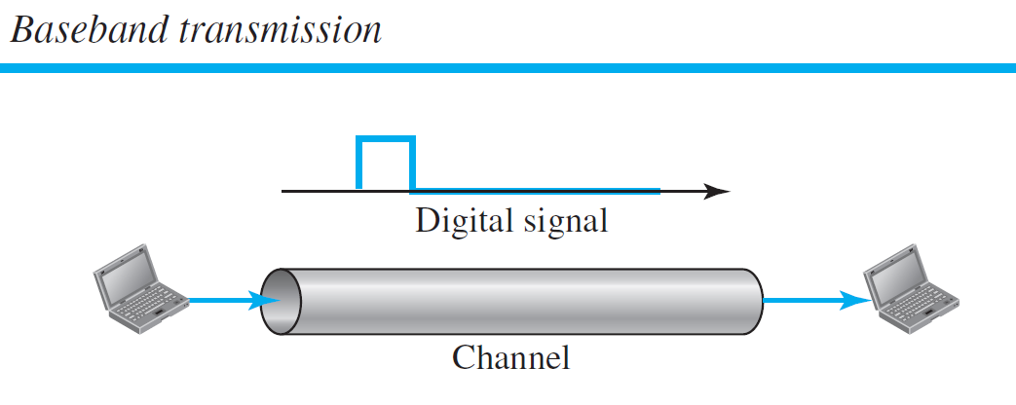
Transmission of Digital Signals
Baseband Transmission
Baseband transmission means sending a digital signal over a channel without changing the digital signal to an analog signal.

Slide 4
Baseband transmission requires :
we have a low-pass channel, a channel with a bandwidth that starts from zero.
This is the case if we have a dedicated medium with a bandwidth constituting only one channel.
For example, the entire bandwidth of a cable connecting two computers is one single channel.
As another example, we may connect several computers to a bus, but not allow more than two stations to communicate at a time.

Slide 5
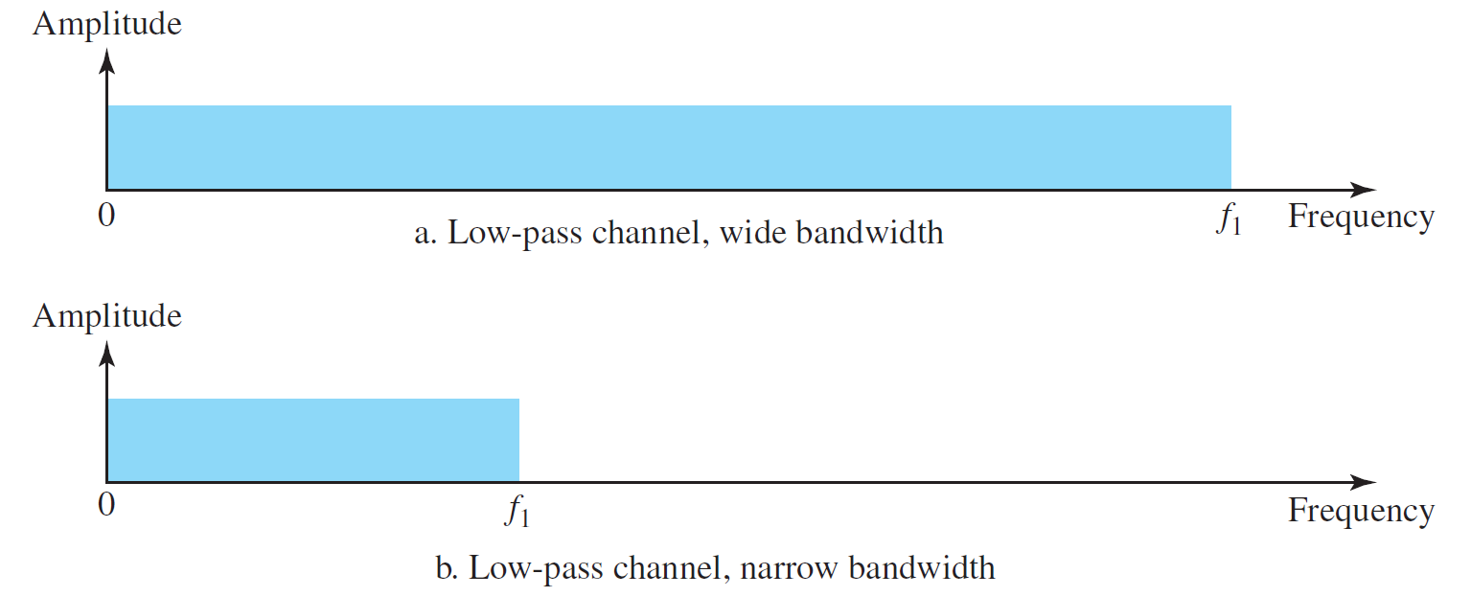
Case 1: Low-Pass Channel with Wide Bandwidth
Case 2: Low-Pass Channel with Limited Bandwidth

Slide 6
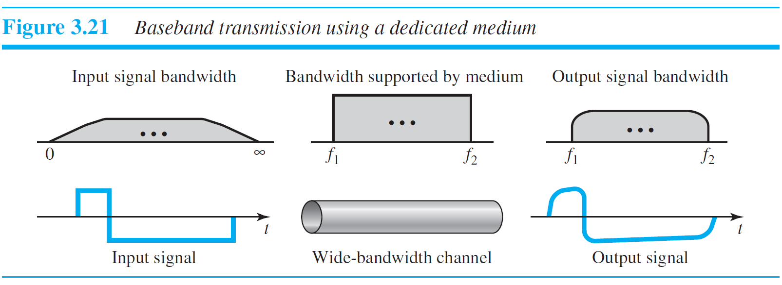
Case 1: Low-Pass Channel with Wide Bandwidth
Note that
f1 is close to zero, and
f2 is very high

Slide 7
Case 2: Low-Pass Channel with Limited Bandwidth
A low-pass channel with limited bandwidth, we approximate the digital signal with an analog signal.
The level of approximation depends on the bandwidth available.
Let us assume that we have a digital signal of bit rate N.
…the worst case, a maximum number of changes in the digital signal.
sequence 01010101 . . . or
the sequence 10101010. . . .

Slide 8
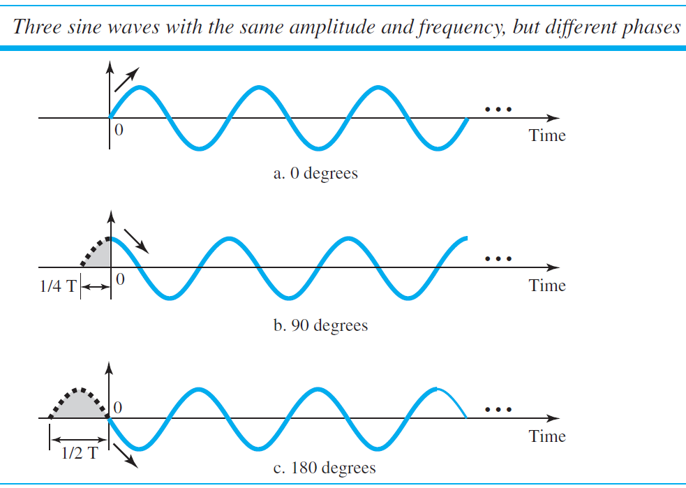
Case 2: Low-Pass Channel with Limited Bandwidth
We need an analog signal of frequency f = N/2.
Let,
1 be the positive peak value and
0 be the negative peak value.
We send 2 bits in each cycle; the frequency of the analog signal is one-half of the bit rate, or N/2.
Just this one frequency cannot make all patterns; we need more components.

Slide 9
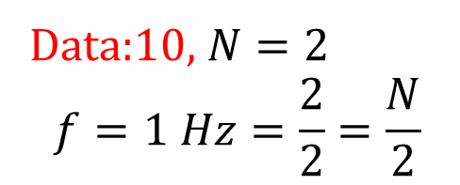

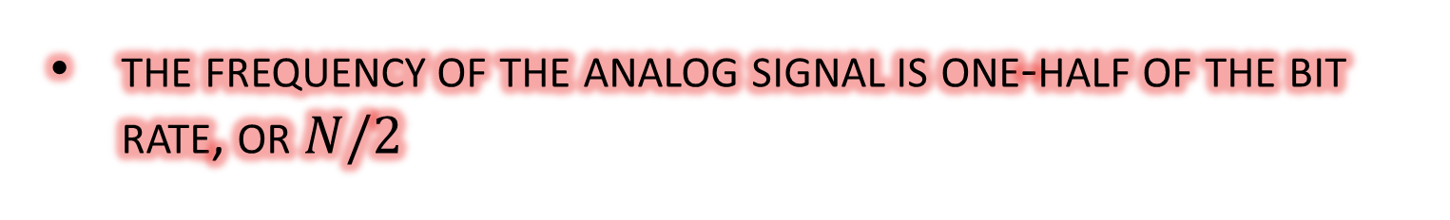
Data:10, $N=2$
$$f=1 Hz=\frac{2}{2}=\frac{N}{2}$$
00
01
10
11
$$0 Hz$$
the frequency of the analog signal is one-half of the bit rate, or $N/2$

Slide 10
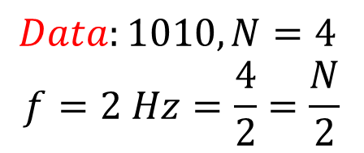
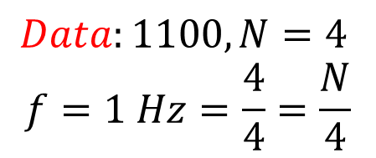
0000
0001
0010
…
1100
…
1111
$$Data:1010, N=4$$
$$f=2 Hz=\frac{4}{2}=\frac{N}{2}$$
$$Data:1100, N=4$$
$$f=1 Hz=\frac{4}{4}=\frac{N}{4}$$
the frequency of the analog signal is one-half of the bit rate, or $N/2$

Slide 11
Case 2: Low-Pass Channel with Limited Bandwidth
Just this one frequency cannot make all patterns; we need more components.
The maximum frequency is N/2.
let us see how a digital signal with a 3-bit pattern can be simulated by using analog signals
000
001
010
011
100
101
110
111

Slide 12
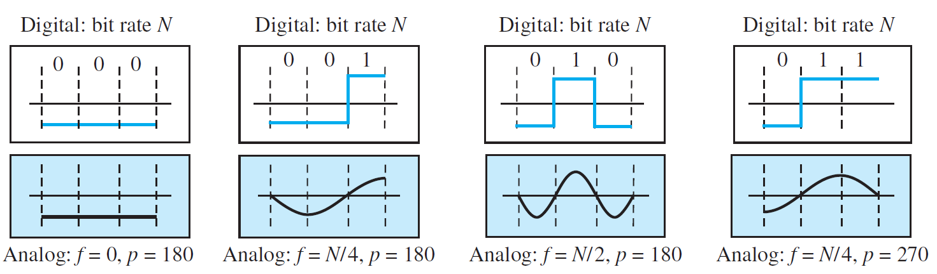
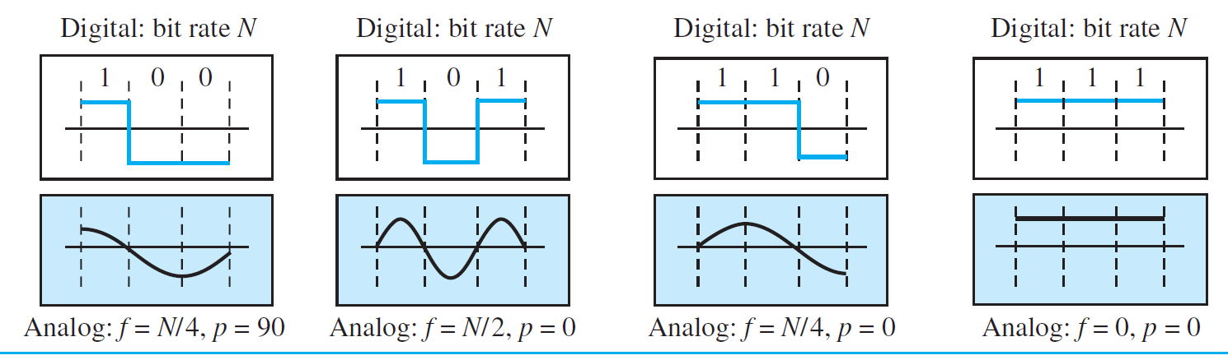

$$N=3$$

Slide 13
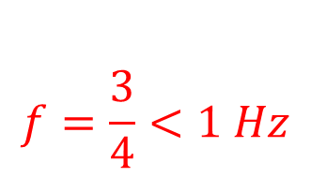
$$f=\frac{3}{4}<1 Hz$$
$$N=3$$

Slide 14
$$N=3$$

Slide 15
$$N=3$$

Slide 16
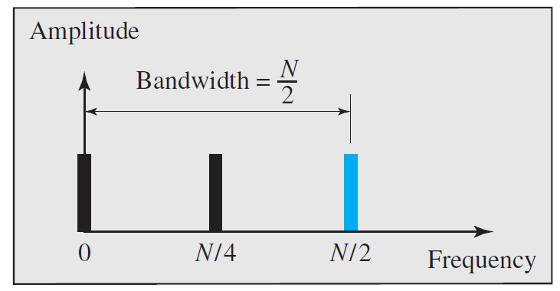

Slide 17
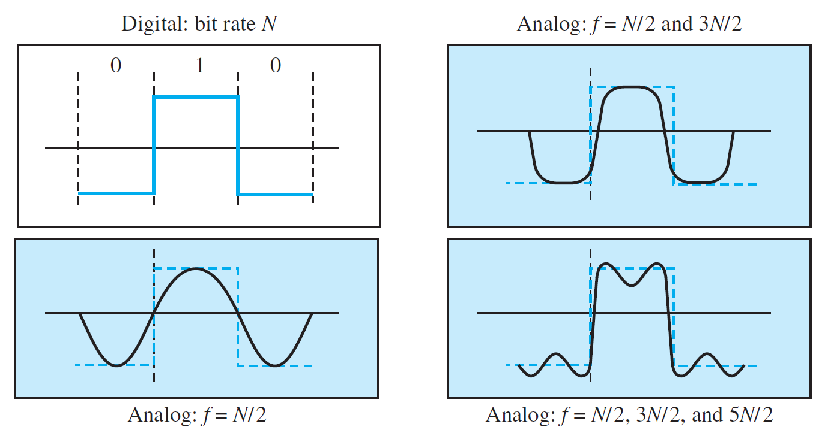
Better Wave

Slide 18
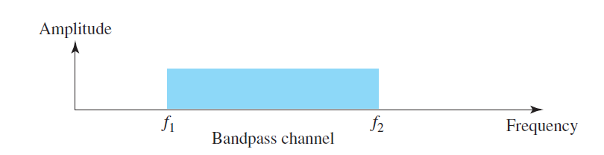
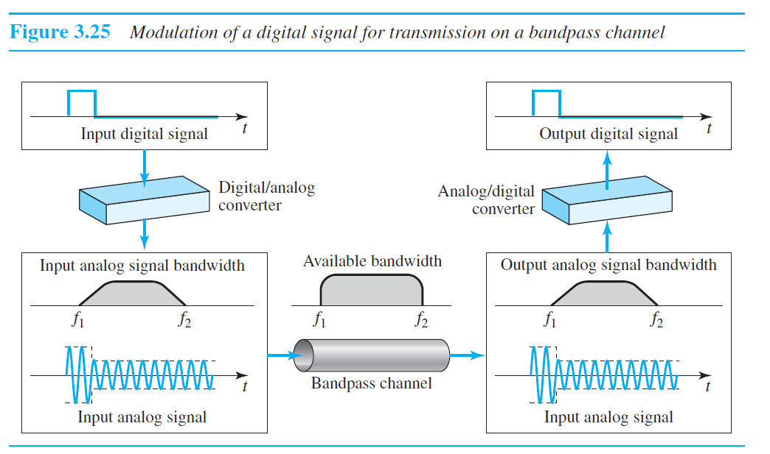
Broadband Transmission (Using Modulation)

Slide 19
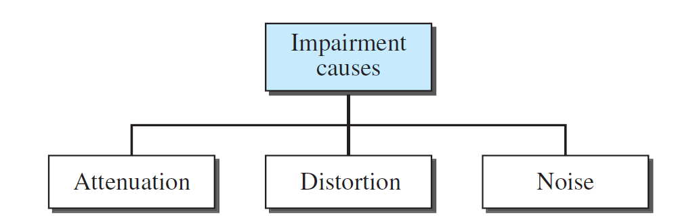
Transmission Impairment
Signals travel through transmission media, which are not perfect.
The imperfection causes signal impairment (damage).
This means that the signal at the beginning of the medium is not the same as the signal at the end of the medium.
What is sent is not what is received.
Three causes of impairment are attenuation, distortion, and noise.

Slide 20
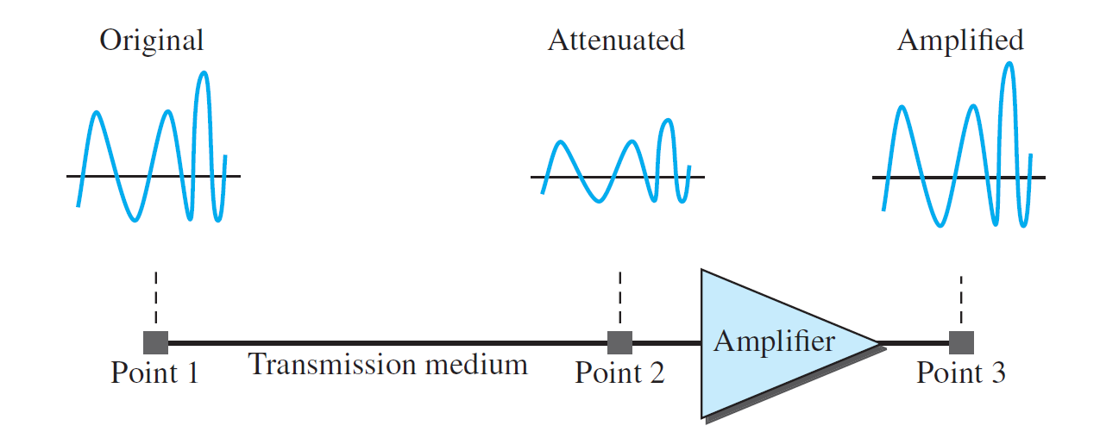
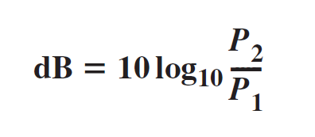
Attenuation
Attenuation means a loss of energy.
Decibel
To show that a signal has lost or gained strength, engineers use the unit of the decibel.
The decibel (dB) measures the relative strengths of two signals or one signal at two different points.
Note that the decibel is negative if a signal is attenuated and positive if a signal is amplified
Variables P1 and P2 are the powers of a signal at points 1 and 2, respectively

Slide 21
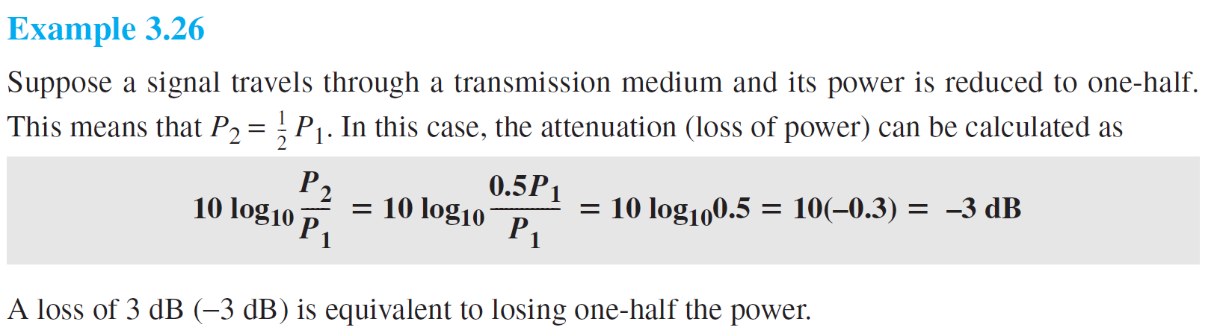
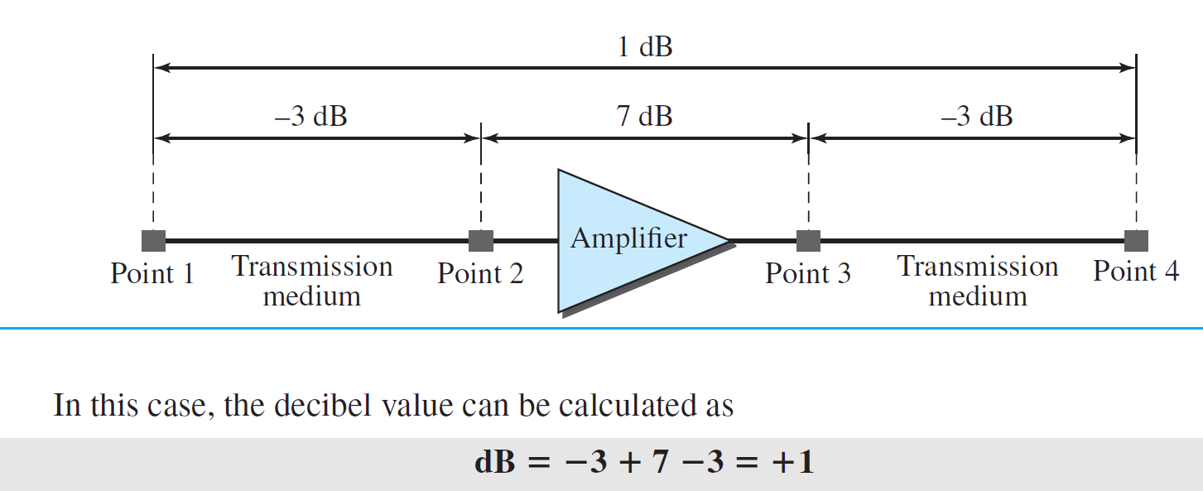
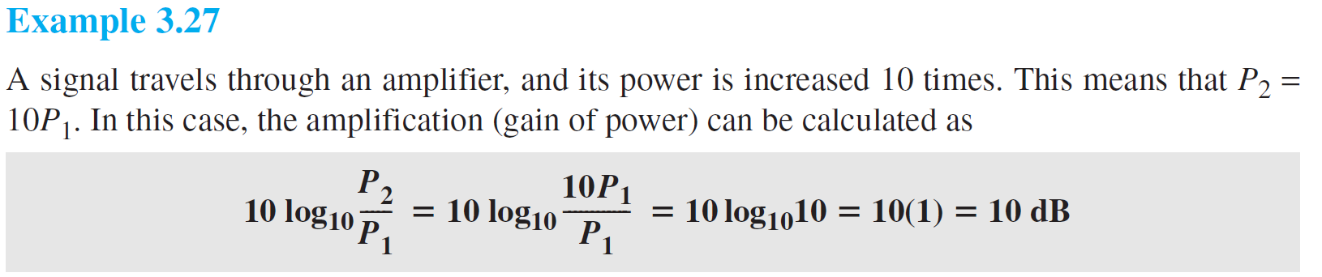

Slide 22
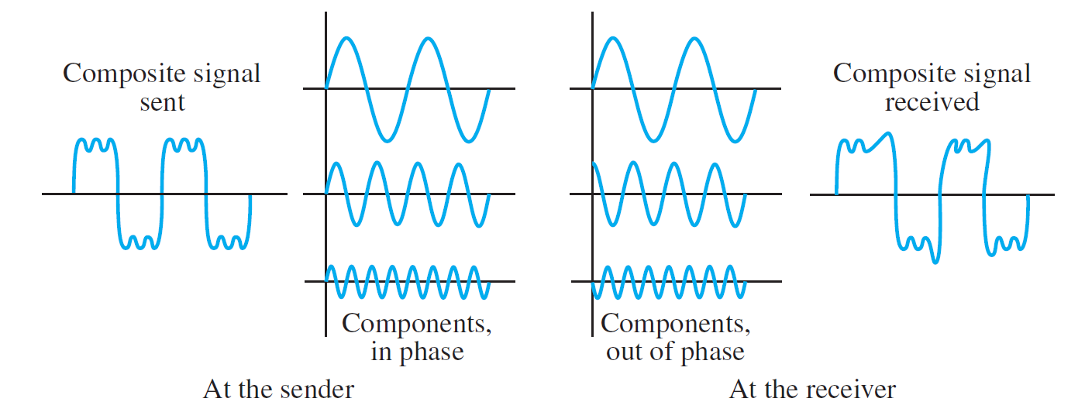
Distortion
Distortion means that the signal changes its form or shape.
Distortion can occur in a composite signal made of different frequencies.
Each signal component has its own propagation speed through a medium and, therefore, its own delay in arriving at the final destination

Slide 23
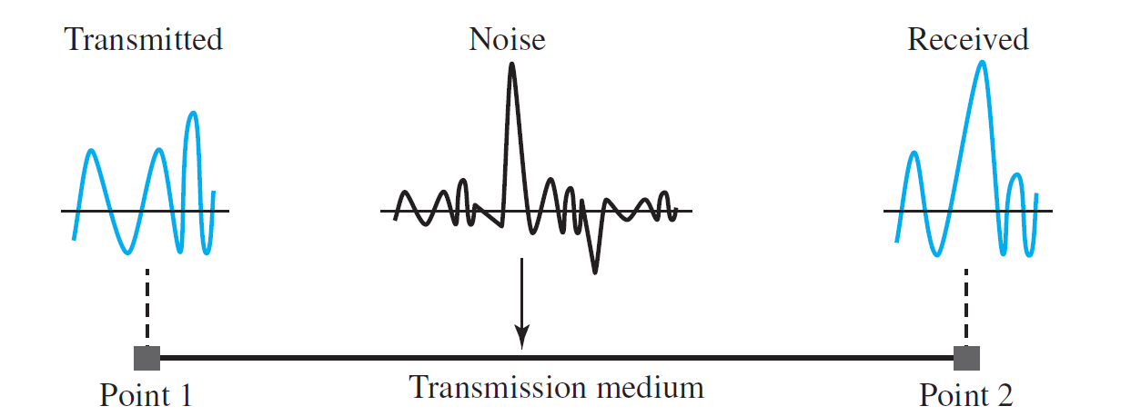
Noise
Noise is another cause of impairment.
Several types of noise, such as thermal noise, induced noise, crosstalk, and impulse noise, may corrupt the signal.
Thermal noise is the random motion of electrons in a wire, which creates an extra signal not originally sent by the transmitter.

Slide 24
Noise
Induced noise comes from sources such as motors and appliances.
These devices act as a sending antenna, and the transmission medium acts as the receiving antenna.
Crosstalk is the effect of one wire on the other.
One wire acts as a sending antenna and the other as the receiving antenna.
Impulse noise is a spike (a signal with high energy in a very short time) that comes from power lines, lightning, and so on.

Slide 25
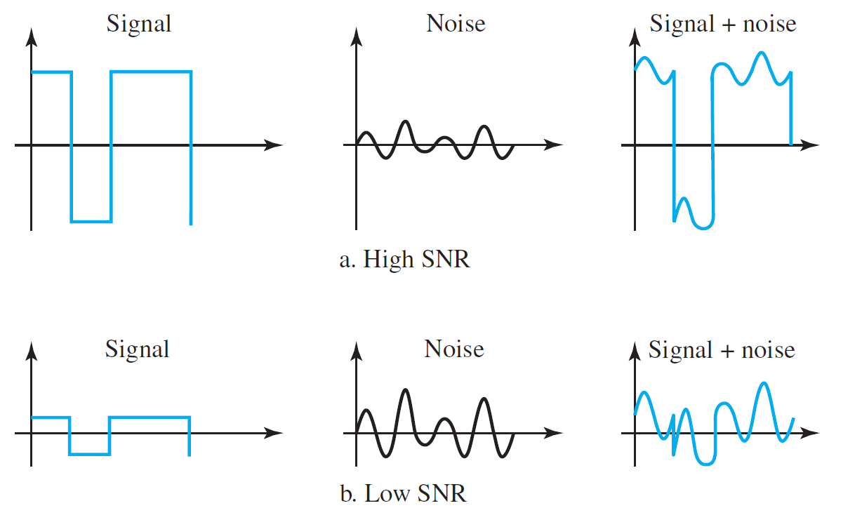
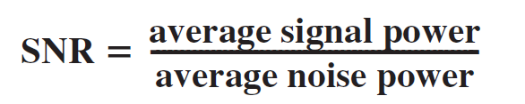
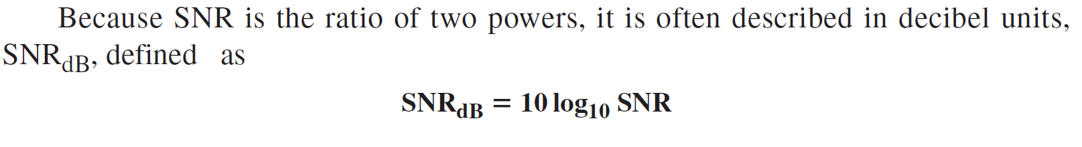
Signal-to-Noise Ratio (SNR)
The signal-to-noise ratio is defined as
A high SNR means the signal is less corrupted by noise;
A low SNR means the signal is more corrupted by noise.

Slide 26
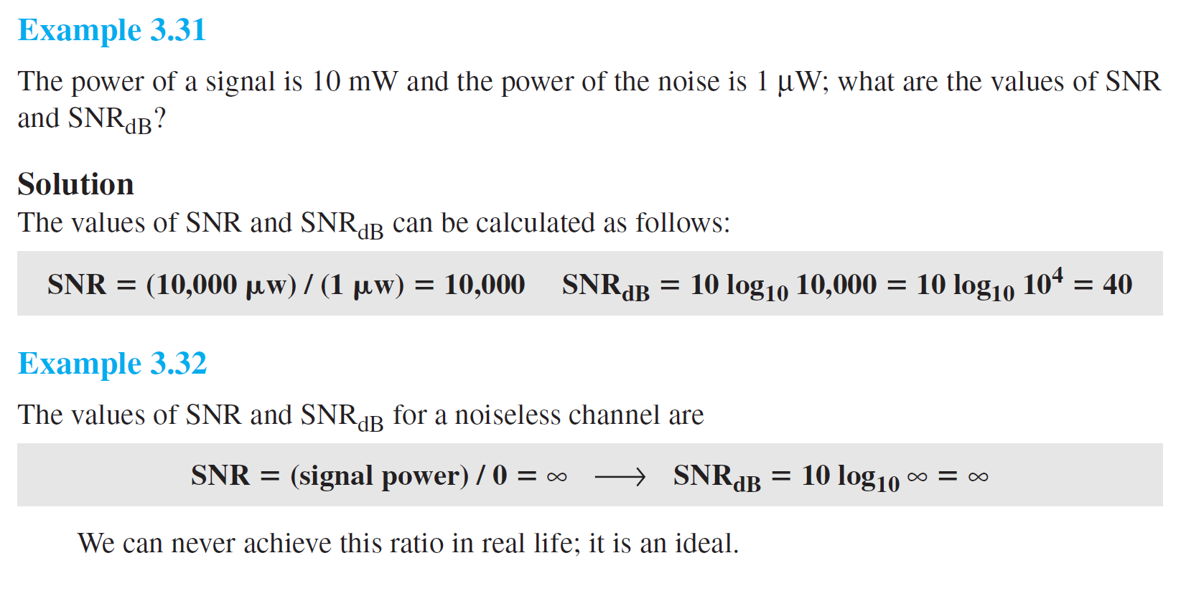
Signal-to-Noise Ratio (SNR)

Slide 27
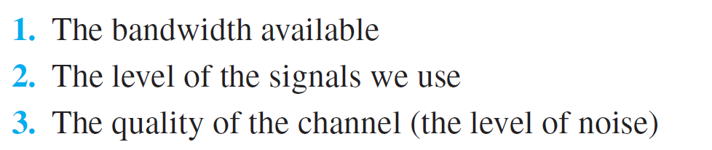
Data Rate Limits
Data rate depends on three factors:
Two theoretical formulas were developed to calculate the data rate:
one by Nyquist for a noiseless channel,
another by Shannon for a noisy channel

Slide 28
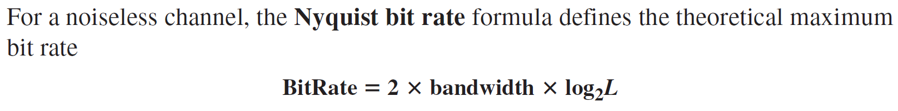
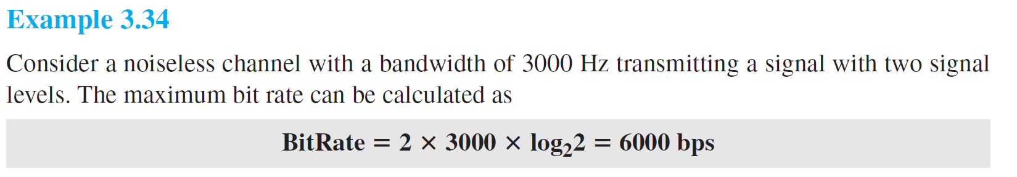
Noiseless Channel: Nyquist Bit Rate
In this formula,
bandwidth is the bandwidth of the channel,
L is the number of signal levels used to represent data, and
BitRate is the bit rate in bits per second.

Slide 29

Noisy Channel: Shannon Capacity
In reality, we cannot have a noiseless channel; the channel is always noisy.
In 1944, Claude Shannon introduced a formula, called the Shannon capacity, to determine the theoretical highest data rate for a noisy channel:

Slide 30
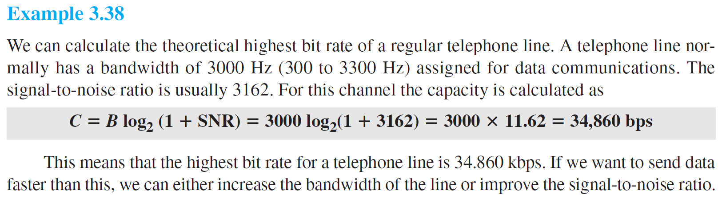

Slide 31
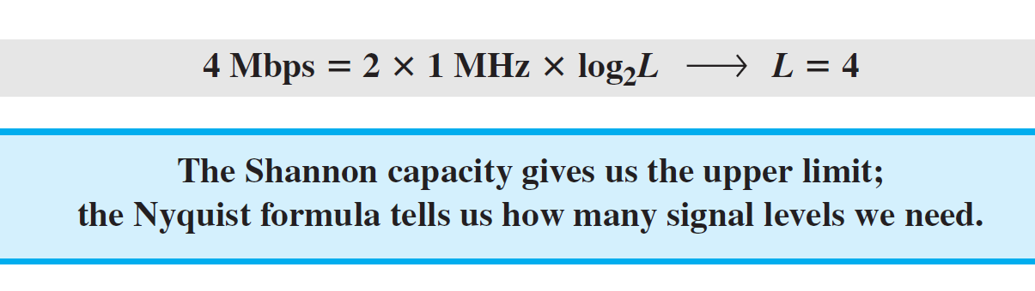
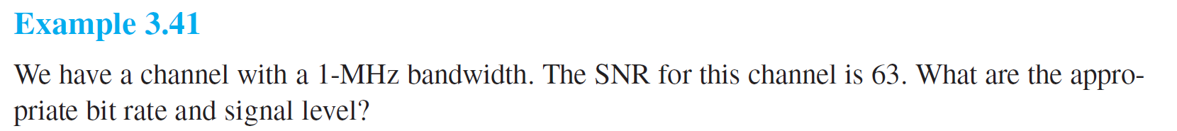
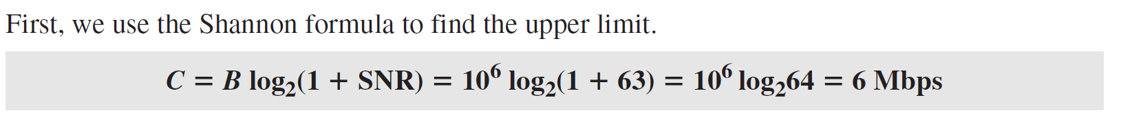
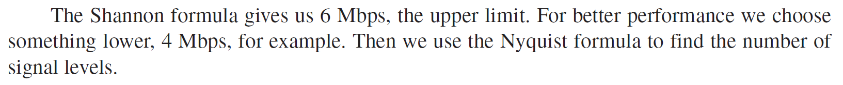
Using Both Limits
In practice, we need to use both methods to find the limits and signal levels.

